Slide 1
Vivisecting Mobility Management in 5G Cellular Networks
ACM SIGCOMM’22, Amsterdam, Netherlands.
Ahmad Hassan†, Arvind Narayanan†, Ruiyang Zhu‡, Anlan Zhang†, Wei Ye†, Shuowei Jin‡, Jason Carpenter†, Z. Morley Mao‡, Feng Qian†, and Zhi-Li Zhang†
†
‡

Slide 2
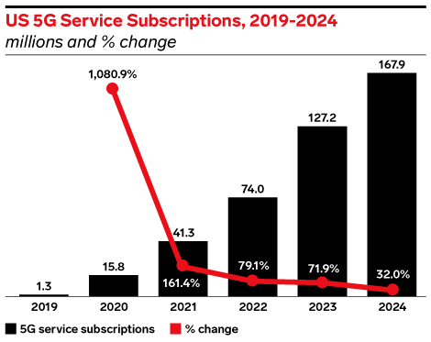
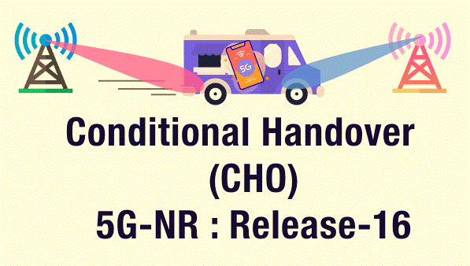
What are today’s 5G mobility management practices? Issues?
What can be done to improve mobility management in future?
New mobility management procedures in 5G
source: insiderintelligence.com

Slide 3
What is mobility management?
4G/5G Core

Slide 4
Handovers interrupt data activity!
4G/5G Core
Handover is triggered
Data activity gets interrupted

Slide 5
5G has made mobility management complex

Slide 6
5G has made mobility management complex
Small coverage areas
Frequent handovers
Network Heterogeneity
Long handover durations
Diversity of radio frequency bands
Higher network fluctuations

Slide 7
What is the impact of mobility on application QoE?
How frequent are handovers in 5G? How much energy they cost?
What impact does mobility have on the 5G network? Issues?
Key handover characteristics
Application QoE
6200+ km, 47000+ handovers
Implications on 5G operators
3 bandwidth-intensive and latency-sensitive applications
3 large 5G carriers in U.S.
Conduct a comprehensive measurement study of mobility management in 5G cellular networks
What can be done to reduce the overhead of mobility?
Handover prediction

Slide 8
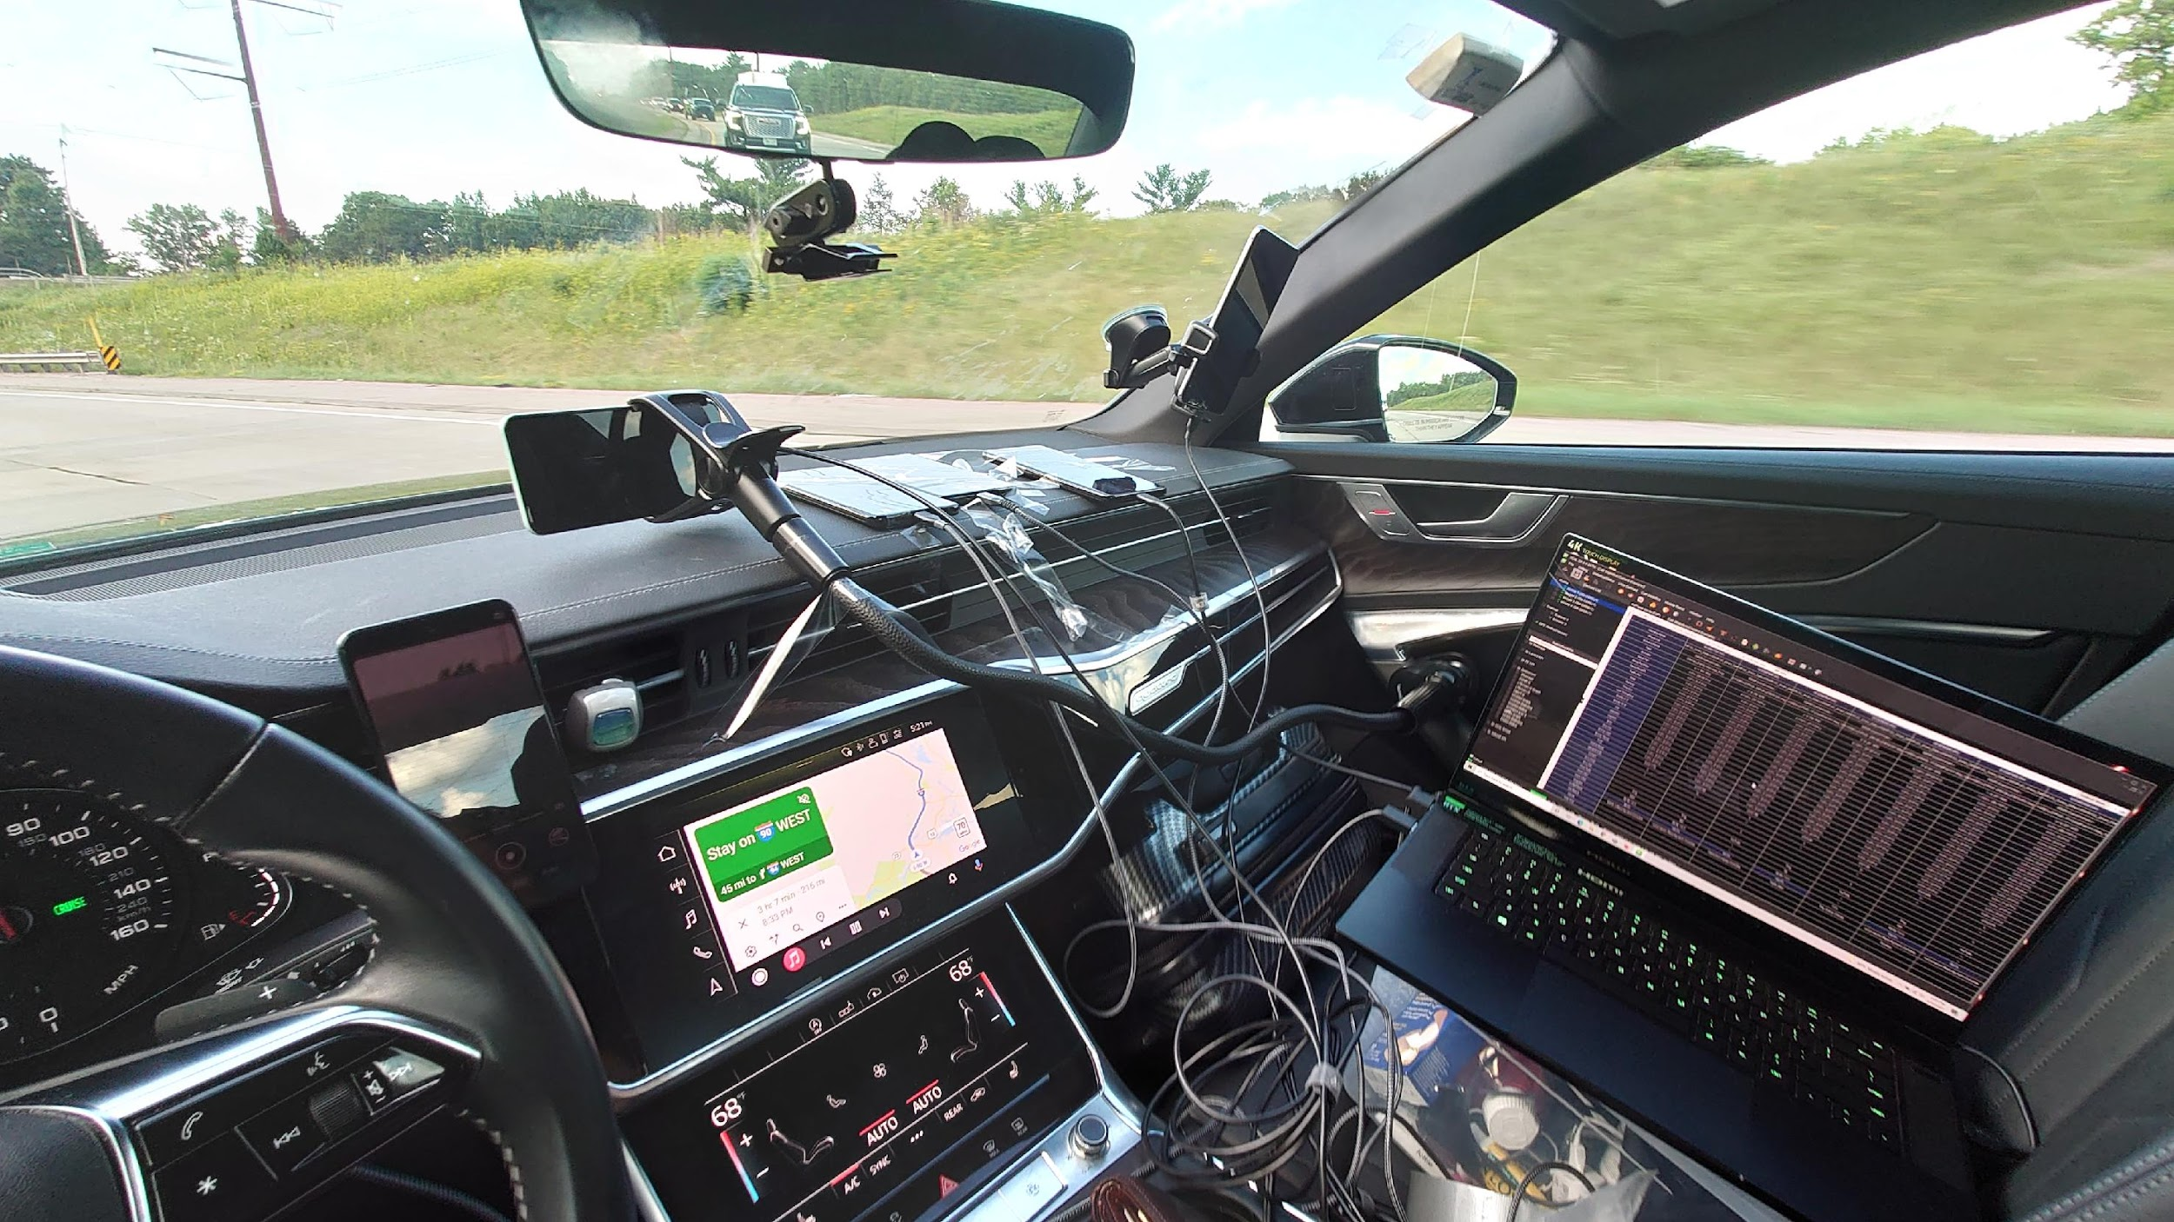
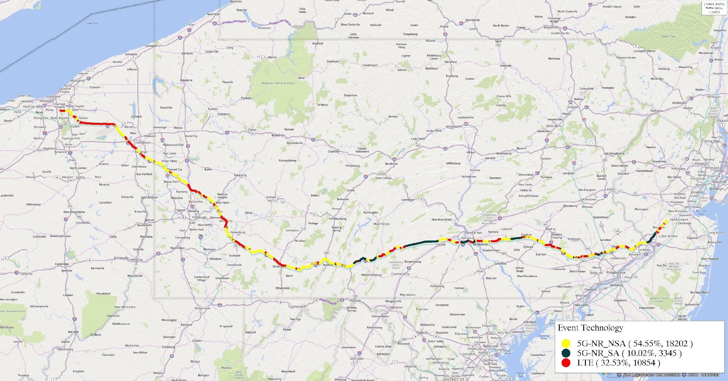
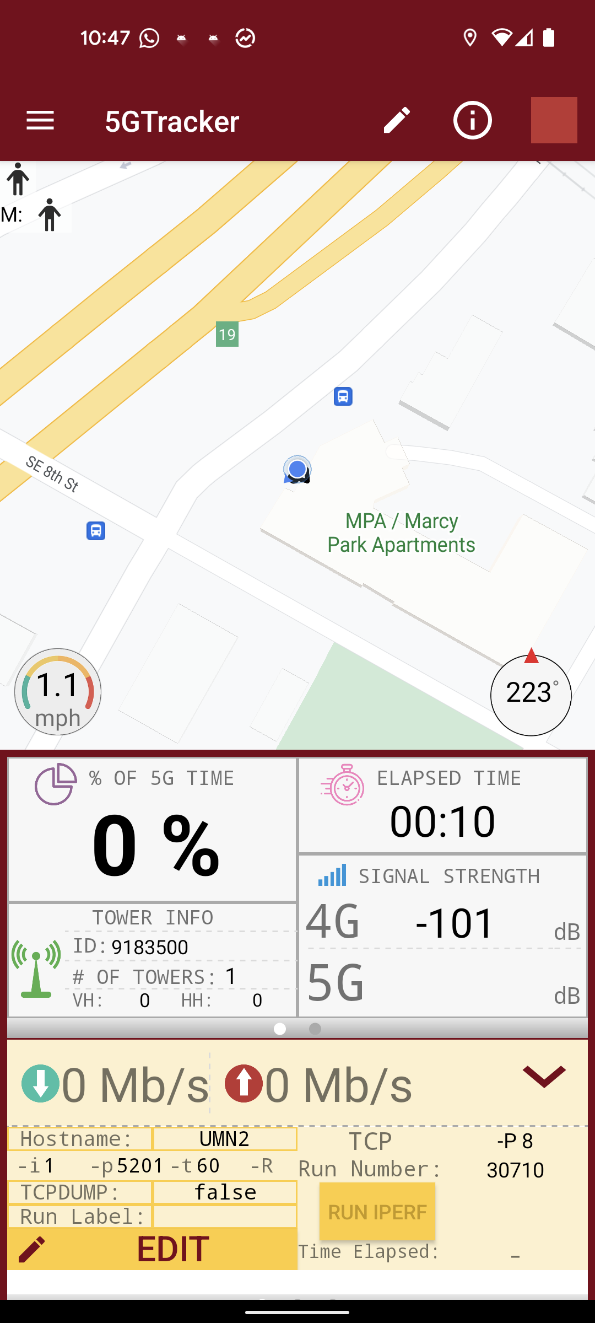
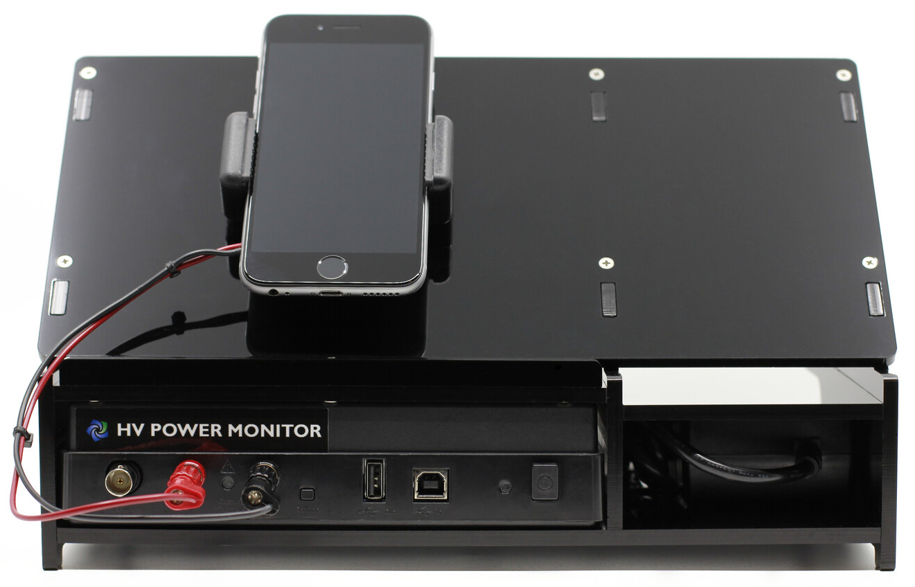
Measurement Testbed
S21 Ultra phones running 5GTracker
Monsoon power monitor and S20U phone
6,200+ km drive tests in the U.S.
Steam cloud play
4G/5G Core
XCAL Laptop
Zoom Laptop
IPerf server
volumetric server

Slide 9
Impact of mobility on application QoE in 5G

Slide 10
Impact of handovers on app QoE is still unknown
Live Video Conferencing
4K Cloud Gaming
Volumetric Video Streaming

Slide 11
4G radio, 5G radio, 4G → 5G
1. Radio access technology
2. Handover type
What factors contribute to mobility-induced QoE fluctuations?
SA vs. NSA
LowBand, MidBand, mmWave
5G-only vs. dual
3. Network architecture
4. Radio frequency bands
5. 5G Deployment mode

Slide 12
Do all handovers have same impact on user QoE?
Setup:
UE @ Minneapolis
Driving Speed 30 mph
Steam cloud play ; 4K@60FPS
5G radio
4G radio
2.26x higher latency and 65% higher dropped frame rate for handovers on 4G radio compared to 5G radio
In NSA 5G, handovers on 4G radio are the main culprits for performance loss

Slide 13
Key characteristics of 5G handovers

Slide 14
Energy Overhead of 5G Handovers
Non-trivial energy footprint for 5G handovers due to high signaling overheads
3.4 mAh
34.7 mAh
81.7 mAh
How does frequent handovers and long handover durations affect the energy consumption of mobile device?
Down:4.3GB Up:2GB
Down:75.4GB Up:14.5GB
130 km/h for 1 hour

Slide 15
What have we discussed so far?
Mobility management in 5G is complex
Application QoE
5G handovers exert far severe impact on QoE than their 4G counterparts
The severity is determined by radio technology, frequency band, architecture, and mode
5G handover characteristics
Interactions b/w 4G and 5G radios significantly increase handover duration in 5G
Handover energy consumption is non-trivial in 5G due to high signaling overheads

Slide 16
Implications of 5G handovers on cellular network

Slide 17
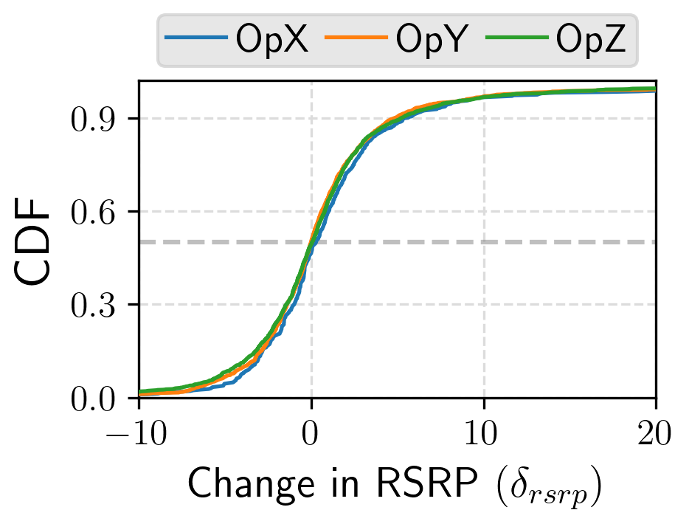
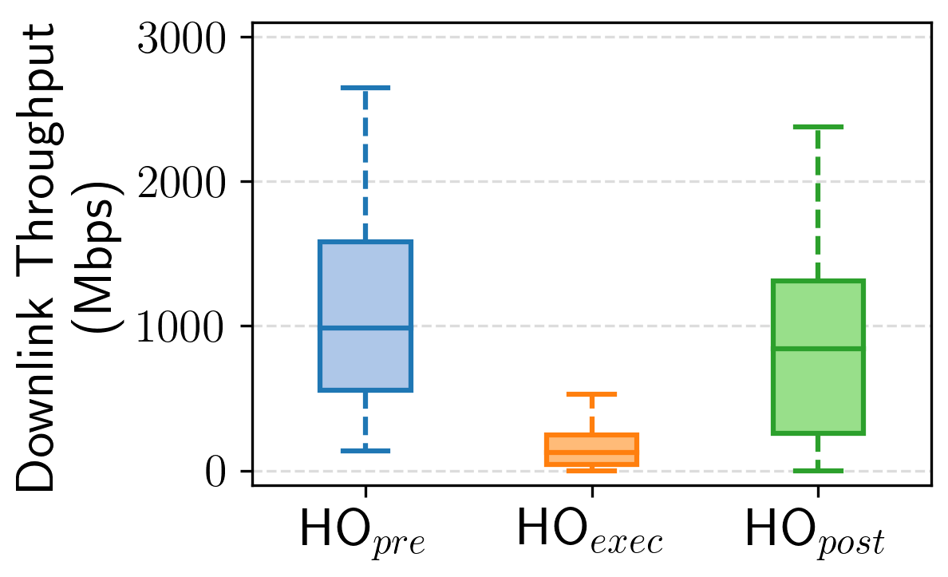
Impact of 5G handovers on network bandwidth
Setup:
UE @ Boston
Driving Speed 30 mph
IPerf Bulk Transfer
5G → 5G (inter-gNodeB handover)
14% reduction
no improvement in median case
Consider the overall handover sequence for 5G → 5G handovers

Slide 18
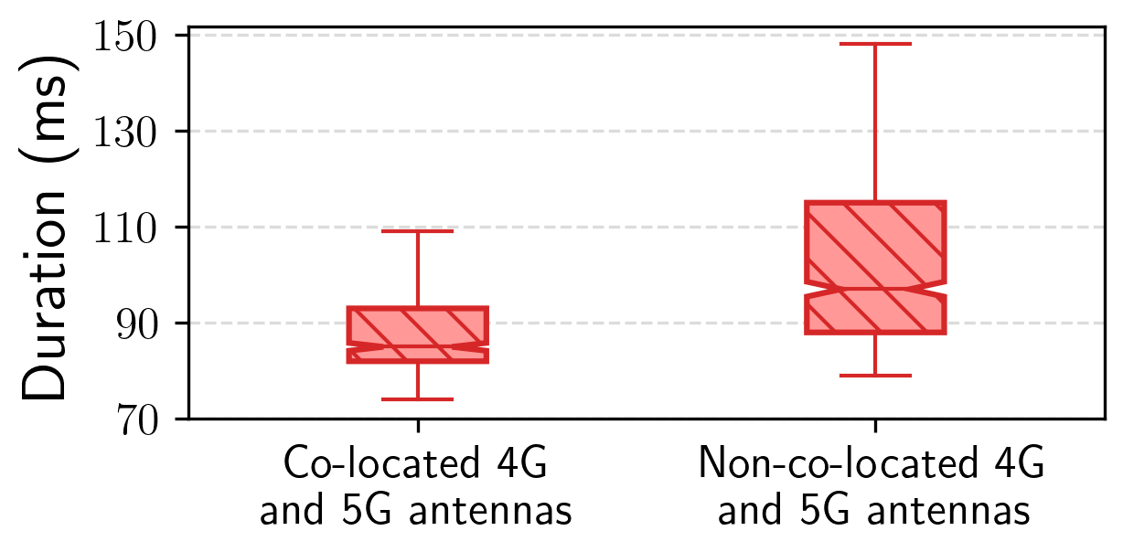
Impact of 4G and 5G radio antenna co-location
consider 4G/5G antenna co-locations during handover decisions
13ms lower latency
co-located 4G and 5G antennas
non-co-located 4G and 5G antennas

Slide 19
Handover prediction

Slide 20
What can we do to mitigate the impact of mobility?
Predict handovers
Estimate network fluctuation due to handover
Applications act proactively

Slide 21
Predict handovers

Slide 22
System Overview
Prognos
Report Predictor
Report Predictor
Decision Learner
Decision Learner
Handover Predictor
event triggered and its report sent to cell tower
Handover Predictor
UE monitors radio environment
UE connects to new cell tower
cell tower makes handover decision
Model prediction system based on the handover state machine

Slide 23
Estimate network fluctuation due to handover

Slide 24
System Overview
Report Predictor
event triggered and its report sent to cell tower
Prognos
UE monitors radio environment
Report Predictor
Decision Learner
Handover Predictor
handover type +
score
UE connects to new cell tower
cell tower makes handover decision
Handover Predictor
Decision Learner
Model prediction system based on the handover state machine

Slide 25
Applications act proactively

Slide 26
16K Panoramic Video Streaming: A Case Study
predicted handover fluctuation (score) → correct ABR throughput estimation
fastMPC
ca
34.6% to 58.6% reduction in stall
robustMPC
Rate-Based (RB)
Prognos helps improve ABR throughput estimation during handovers

Slide 27
Key Findings and Takeaways
Application QoE
5G handovers exert far severe impact on QoE than their 4G counterparts
The severity is determined by radio technology, frequency band, architecture, and mode
5G handover characteristics
Interactions b/w 4G and 5G radios significantly increase handover duration in 5G
Handover energy consumption is non-trivial in 5G due to high signaling overheads
Key mobility issues in 5G
Consider the overall handover sequence for 5G → 5G handovers to improve performance
Consider the 4G/5G antenna co-locations to reduce handover duration
Handover prediction
Prognos is an on-device solution, and works with any 3GPP-compliant 4G/5G deployment
It outperforms existing handover prediction methods in our evaluation
It improves the QoE for 16K panoramic video streaming and volumetric video streaming

Slide 28
A comprehensive measurement study of mobility management in 5G cellular networks
1. Application QoE
3. Implications on 5G carriers
2. Key handover characteristics
4. Handover prediction
github.com/SIGCOMM22-5GMobility/artifact
Ahmad
Hassan
Arvind
Narayanan
Ruiyang
Zhu
Anlan
Zhang
Wei
Ye
Shuowei
Jin
Jason
Carpenter
Z. Morley
Mao
Feng
Qian
Zhi-Li
Zhang
Our Team
Reach out to us: hassa654@umn.edu

